Slide 1

Acme Garage Door Company’s
Simulated Garage Door Opener System (SiGDOS)
Presented by:
Francis Ani & J.R. Armstrong

Slide 2
Background
Acme Garage Door Company
  Founded in 2009
  Evaluation before production of first product
Two person software development team
  Francis Ani
  J.R. Armstrong
Primary constraints
  Four week development timeframe
  Design must be highly modifiable

Slide 3
Product Design
Project Mission Statement
Use Case Diagram
Use Case Descriptions
User-Level Requirements
Prototype

Slide 4
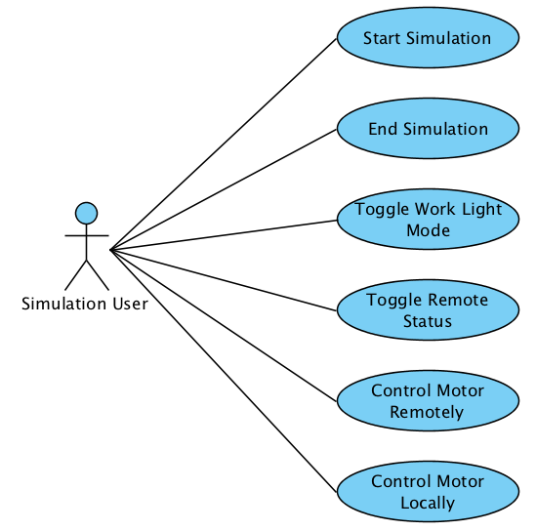
Use Case Diagram

Slide 5
Architectural Design Development
Conceptual Model
  Functional Decomposition
  Modular Decomposition
  Combined Decomposition
  Class Diagram
Utility Tree
Profiles and Scenarios
Architectural Scoring Matrix
Architectural Design Rational

Slide 6
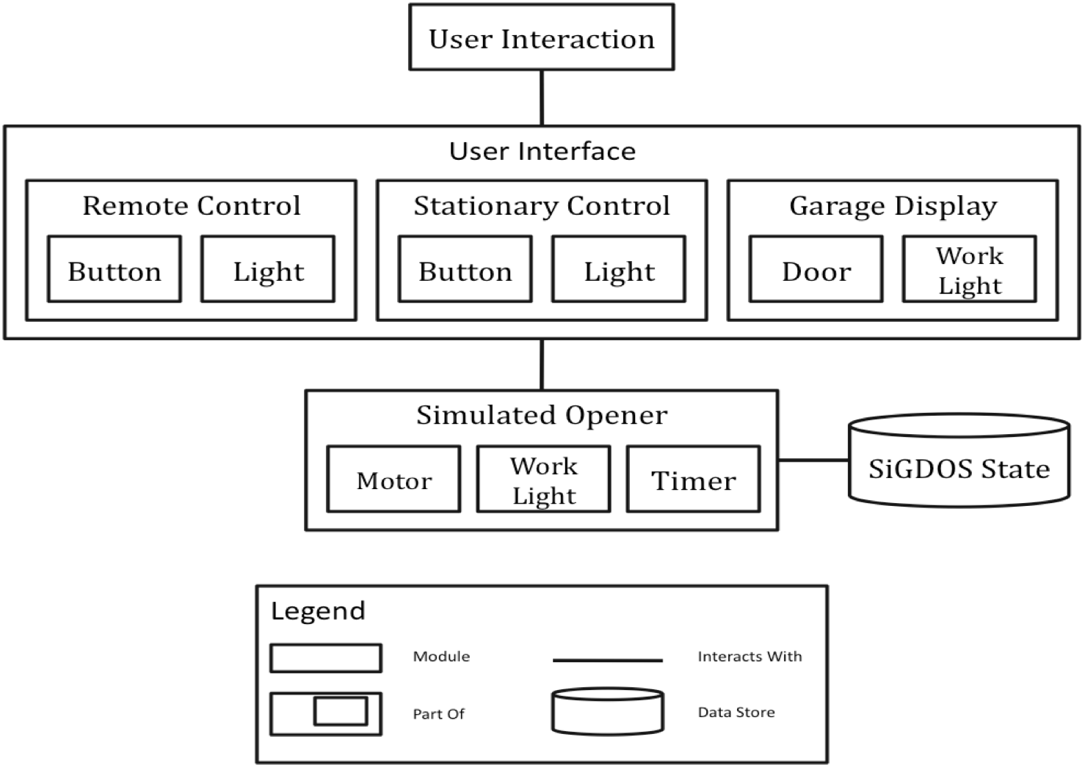
Combined Decomposition

Slide 7
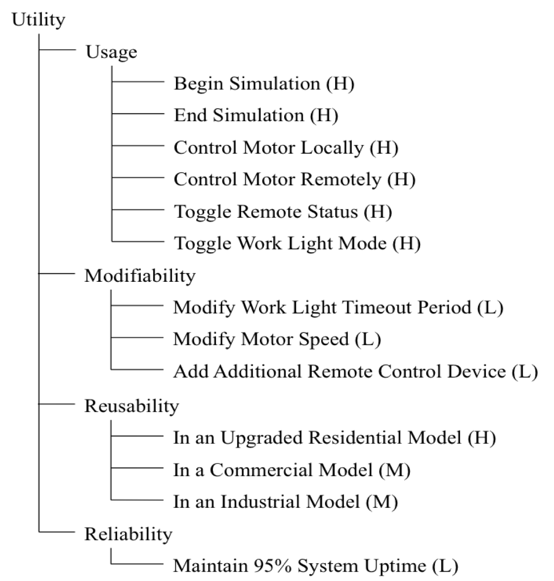
Utility Tree

Slide 8
Architectural Design Rationale
Layered approach
  Control devices placed in user interface layer
  System logic placed in simulation layer
  Data store layer maintains state between sessions
Emphasis on modifiability
Work light even/odd count scheme abandoned in favor of a conceptually simpler toggle

Slide 9
Detailed Design Development
Class Diagrams
Operation Specification
Sequence Diagrams
State Chart
Mapping Between Models
Detailed Design Rationale

Slide 10
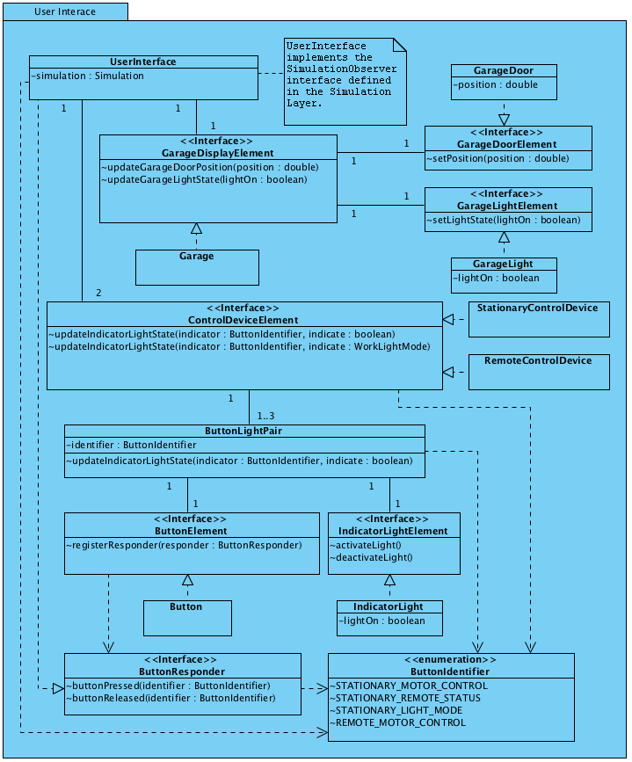
User Interface Layer

Slide 11
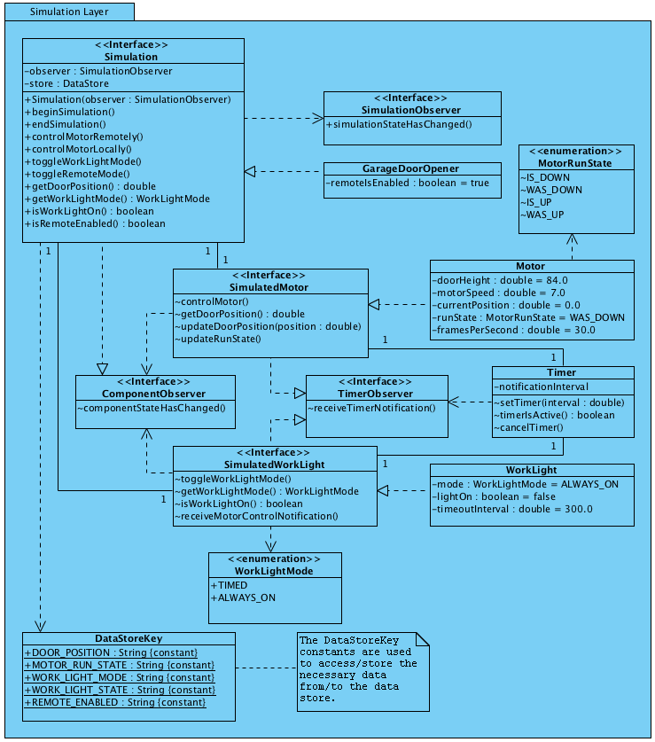
Simulation Layer

Slide 12
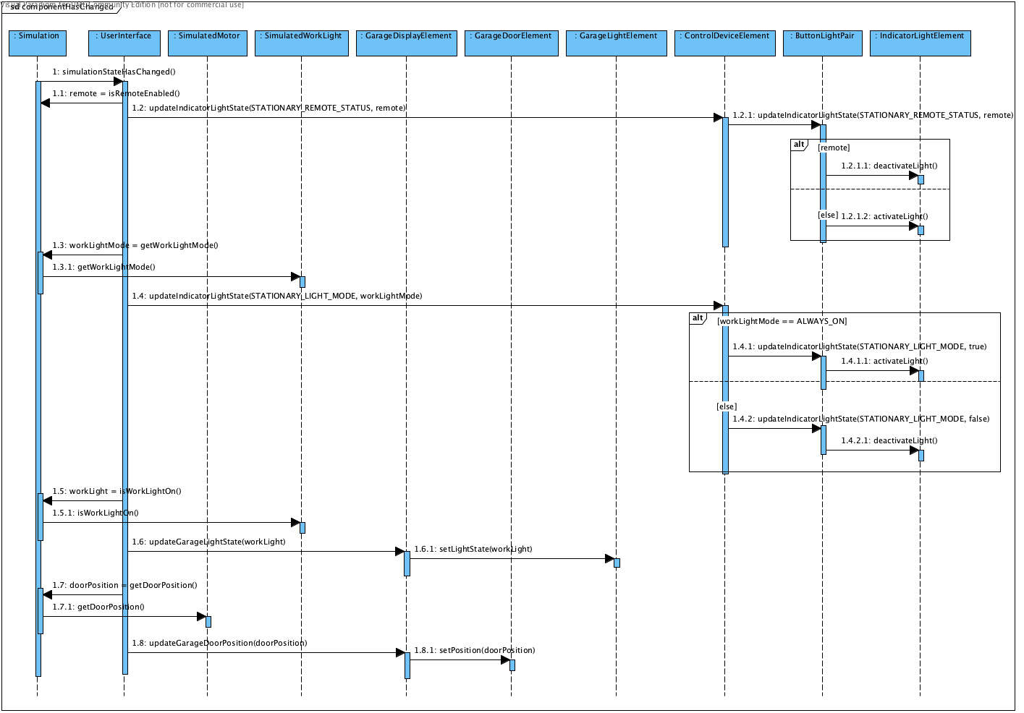
Sequence Diagram for State Changes within the Simulation Layer

Slide 13
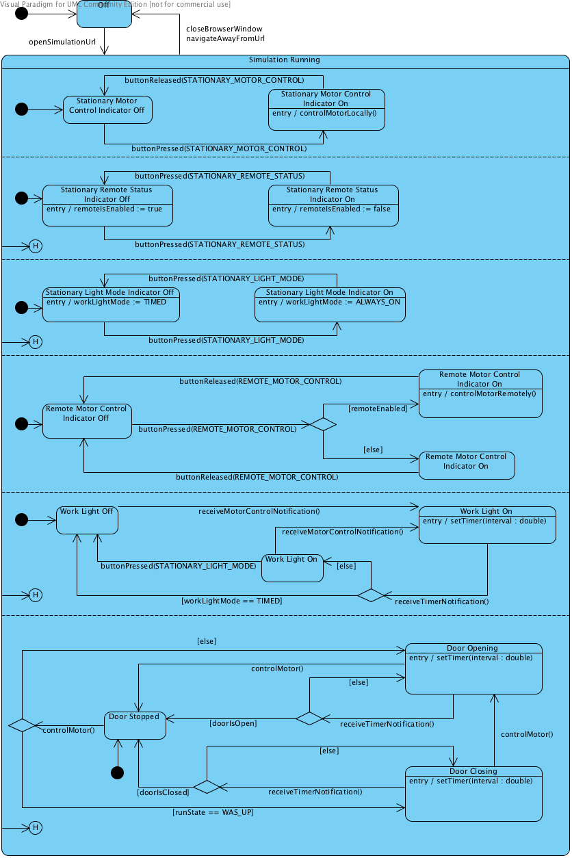
State Chart

Slide 14
Detailed Design Rationale
Detailed design provided confirmation of architecture design
Two priorities emphasized
  Core functionality
  Modifiability
Detailed design fulfills the requirements set forth in the SRS

